Slide 1
Polarity of Molecules
October 2016

Slide 2

Electronegativity
Is the relative measure of an atom’s ability to attract electrons in a chemical bond
The larger the value, the greater the atom’s ability
Q? Which element should have the greatest electronegativity?
Q? Periodic trend?

Slide 3
Electronegativity
A covalent bond is the sharing of valence electrons between two non-metal atoms
Electronegativity values help us determine how well the 2 atoms are sharing
This leads to the formation of 2 different types of covalent bonds: polar and non-polar

Slide 4
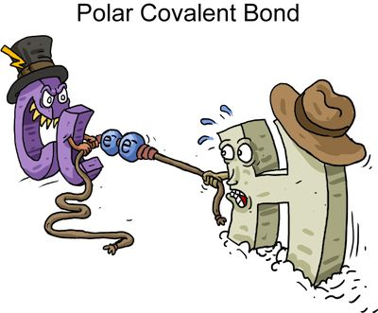
Polar Covalent Bonds
Form between 2 non-metal atoms that have different en values
i.e. H Cl
The atom with the higher en value pulls the valence electron closer to it and therefore further away from the atom with the lower value

Slide 5
Polar Covalent Bonds
This creates a distorted distribution of electrons between the 2 atoms forming what are called partial charges
The atom with the higher en takes on a slightly negative nature (since electrons are sitting closer to it) leaving the other atom with a slightly positive charge

Slide 6

This distortion can be illustrated 2 ways:

Slide 7
Assign partial charges to the following bonds:
C-O
O-H
N-Cl
P-H
F-F
C-H

Slide 8
Calculate Δen and then rank the following bonds from greatest to least polar:
C-O
O-H
N-Cl
P-H
F-F
C-H

Slide 9
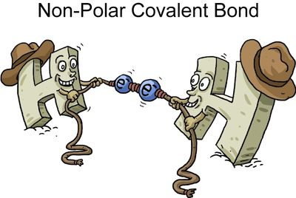
Non-Polar Covalent Bonds
Form between 2 non-metal atoms that have the same or close to the same en values
i.e. H H
Since they are sharing electrons equally well, no distortion of the bond occurs and therefore no partial charges are formed

Slide 10
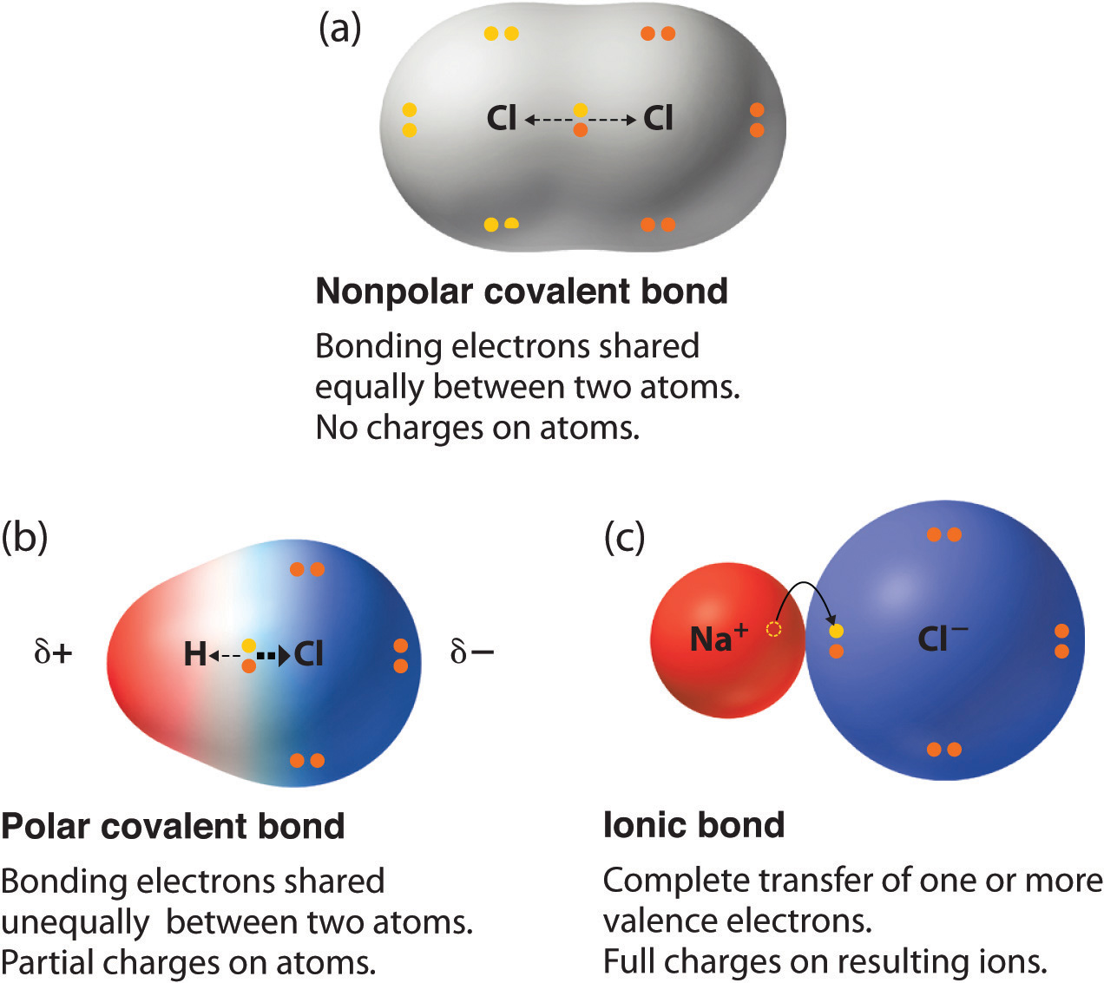

Slide 11
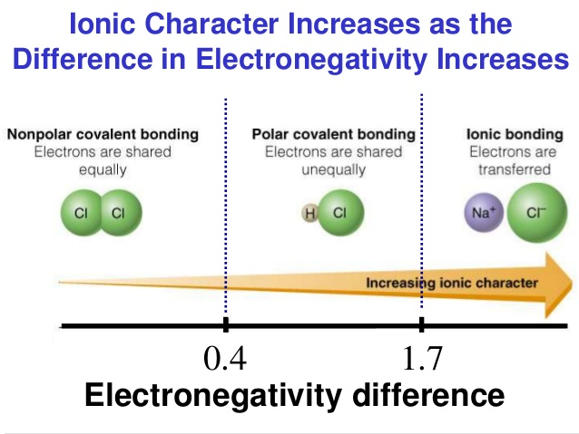
The Bonding Continuum

